Slide 1
Software Requirement Engineering (SE-211)
Lecture 28: Estimation

Slide 2
Estimation
Experience and Beware of the Sales Guy

Slide 3
Cost Estimation
Project scope must be explicitly defined
Task, functional, or component decomposition is necessary
Historical measures (metrics) are very helpful
To assure fit, use two or more estimation techniques
Uncertainty is inherent in most estimation endeavors – plan on it!

Slide 4
Planning Poker is a consensus-based estimation technique used by Agile teams globally.

Slide 5
Step-01: Organization of the game
Full team will involve in Planning Poker game.
Will require 2–4 hours
Also require a large table where all members will sit.
Each team member will have a set of cards
In each card set there will have 10 cards with numbering 0, 1, 2, 3, 5, 8, 13, 21, 40 and 100 i.e. 1st card’s no will 0, 2nd card’s no will 1, 3rd card’s no will 2, 4th card’s no will 3, 5th will 4, 6th will 8, 7th will 13, 8th will 21, 9th will 40 and 10th will 100

Slide 6
Step-02: Introducing Story by Product Owner
The Product Owner introduces the user story by talking about:
The motivation for doing the user story.
The intended outcome and benefits.
The scope of the user story (including what is not in scope with this user story).
Other relevant considerations.

Slide 7
Step-03: Discussing about the Story
What should happen in a given scenario?
What should happen in some negative case or edge case (i.e. plausible but not common scenario)?
Do we need to build this for one type, several user types or all users?
Do we need to track any new performance metrics in order to understand if this user story is working as expected?

Slide 8
Step-04: Playing Cards
After discussion team members will ask to point for that story i.e. Product owner will ask them Now Select your card for assign Story Point to this story
Each team member will select their card and put it on the table with face down, so that others can’t see his/her point.

Slide 9
Step-05: Achieving Consensus
Most of the time one thing will identify which is a huge mismatch between given numbers.
In that case members with highest and lowest numbers will ask why their chose estimates
They will give some justification and discuss with the team regarding this issue. This will also help the team if they have any misunderstanding or vogue idea about the story and adjusting their estimation
After justification the process i.e. Step-04 will continue again
This process will continue until all members agrees to a common estimate
Once all team members agrees to a common estimate then Product owner will record that point and go for next story and will continue from step-02 to step-05
If after 5–6 rounds of playing the game estimation fail meet all members agreement then put it aside for revisit later

Slide 11




HOW IT WORKS

Slide 12



HOW IT WORKS

Slide 13

HOW IT WORKS

Slide 14
HOW IT WORKS

Slide 15


HOW IT WORKS

Slide 16

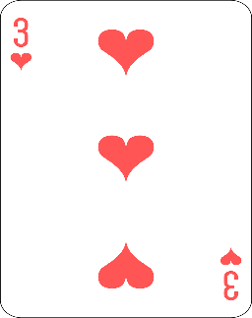
HOW IT WORKS

Slide 17
HOW IT WORKS

Slide 18
HOW IT WORKS

Slide 19


HOW IT WORKS

Slide 20

HOW IT WORKS

Slide 21

DISAGREEMENTS
HOW TO GET THE FINAL ESTIMATE
Keep voting until everyone votes the same number
Keep voting until estimates are “close enough” and average them
Average the votes even if they’re not very close
When averaging, keep exact average or round up

Slide 22
DISAGREEMENTS
HOW TO GET THE FINAL ESTIMATE
NUMBER SEQUENCING
Playing Cards:
Ace, 2, 3, 4, 5, 6… King
Modified Fibonacci:
0, ½, 1, 3, 5, 8, 13, 20, 40, 100
Sequential:
0, ½, 1, 2, 3, 4, 5, 6, 7, 8, 9, 10, 15…
T-Shirt Sizes:
xxs, xs, s, m, l, xl, xxl
With Icons:
Infinity means it can’t be done, coffee cup means I need a break
And what do the numbers mean? Story points, ideal days, etc.

Slide 23
DISAGREEMENTS
HOW TO GET THE FINAL ESTIMATE
NUMBER SEQUENCING
TO TIME OR NOT TO TIME
Original purpose was to keep estimation meetings moving (Agile Alliance)
Use a timer to limit each round?
Use a timer to limit vote justifications?
How long to set in both cases?

Slide 24
DISAGREEMENTS
HOW TO GET THE FINAL ESTIMATE
NUMBER SEQUENCING
TO TIME OR NOT TO TIME
?

Slide 25

BENEFITS
Promotes accuracy, prevents bias
Keeps things organized & moving
Can assist in task assignment
Allows for multiple timelines based on cuts

Slide 26

196
RAW MATH
6 Devs
5 days/week
30 points/week
196/30 = 6.4 weeks!

Slide 27
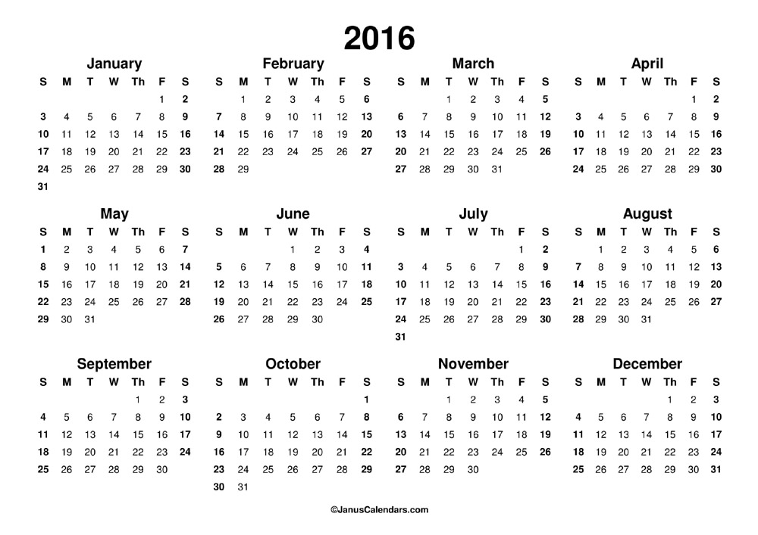

Slide 28
196
RAW MATH = 6.4 weeks
VELOCITY
20 points/week
196/20 = 9.8 weeks!

Slide 30
196
RAW MATH = 6.4 weeks
VELOCITY = 9.8 weeks
MAINTENANCE
3 points/week
Velocity = 17/week
196/17= 11.5 weeks!

Slide 32
196
RAW MATH = 6.4 weeks
VELOCITY = 9.8 weeks
MAINTENANCE = 11.5 weeks
UNKNOWNS
35% increase!
196 * .35 = 67.55
196 + 67.55 = 263.55
263.55/17 = 15.5 weeks!

Slide 34
196
RAW MATH = 6.4 weeks
VELOCITY = 9.8 weeks
MAINTENANCE = 11.5 weeks
UNKNOWNS = 15.5 weeks
DAYS OFF
Thanksgiving = 1 week
Vacations/Sick = 1 week
Total = 17.5 weeks

Slide 36
196
RAW MATH = 6.4 weeks
VELOCITY = 9.8 weeks
MAINTENANCE = 11.5 weeks
UNKNOWNS = 15.5 weeks
DAYS OFF = 17.5 weeks
QUALITY ASSURANCE
Regression Testing & Cleanup = 1 week
Total = 18.5 weeks!

Slide 38

PLAN FOR
HISTORICAL VELOCITY
MAINTENANCE
UNKNOWNS
DAYS OFF
QUALITY ASSURACE

Slide 41
COCOMO II

Slide 42
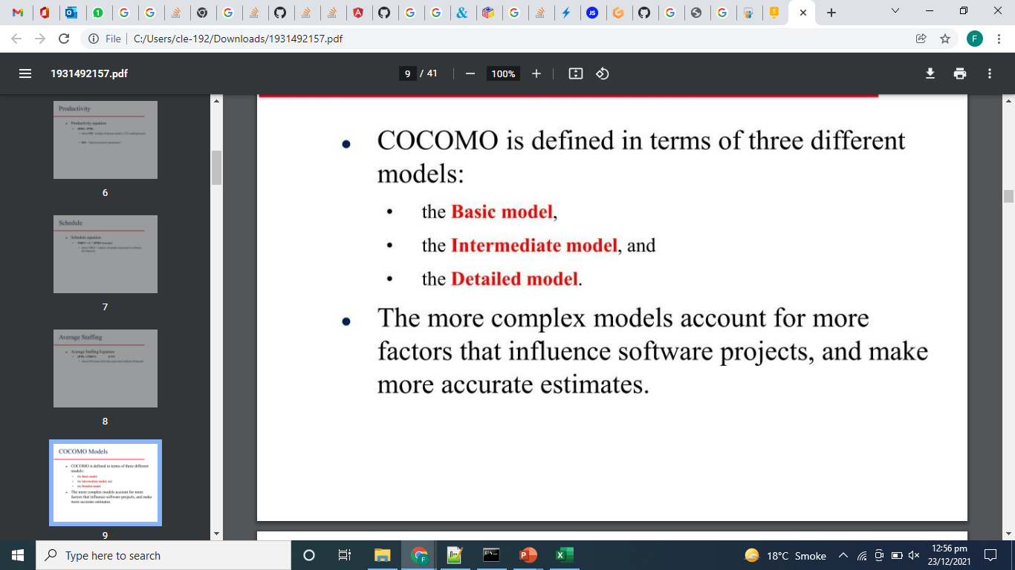
COCOMO II

Slide 43
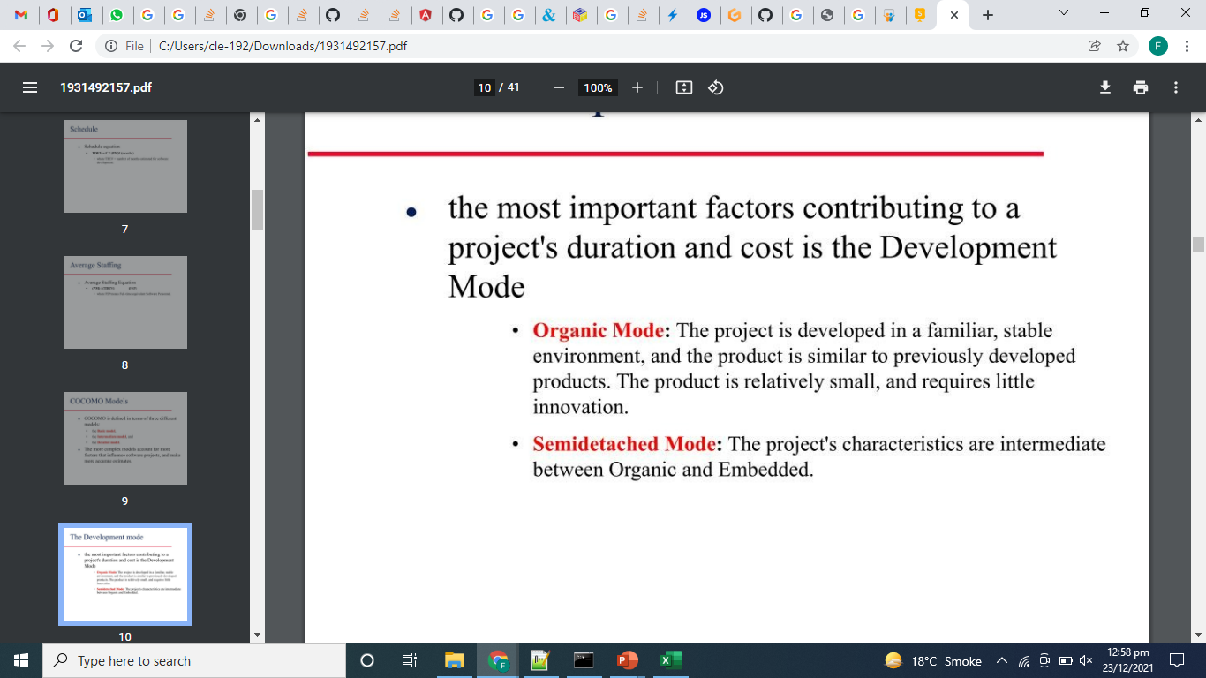
The Development Mode

Slide 44
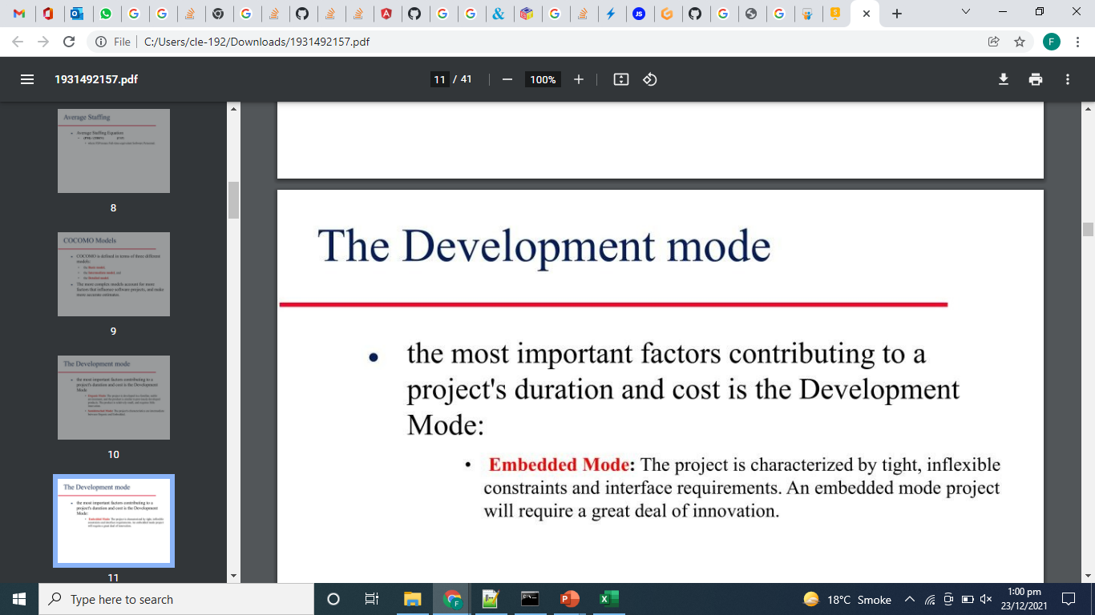
The Development Mode

Slide 45
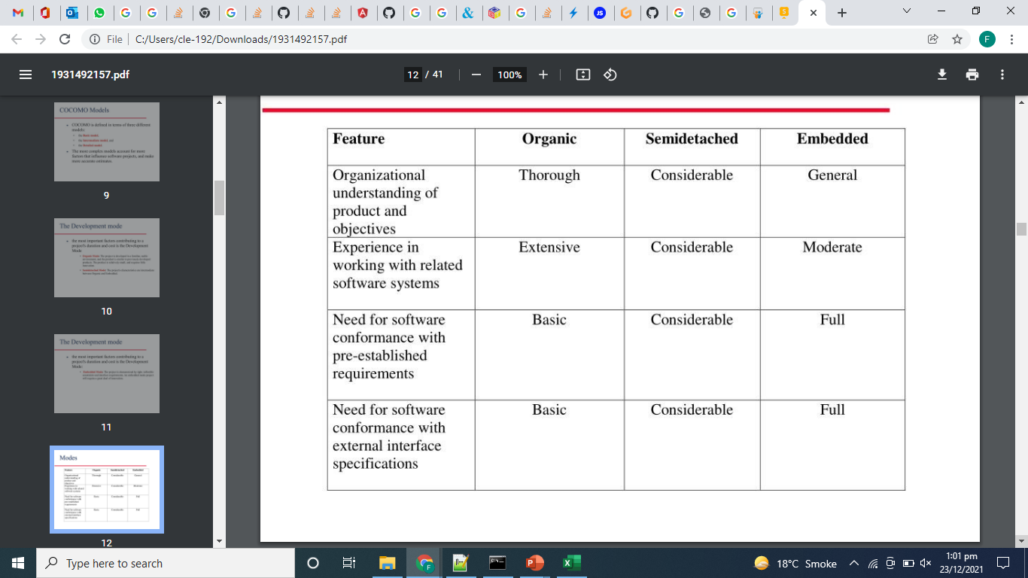
Modes

Slide 46
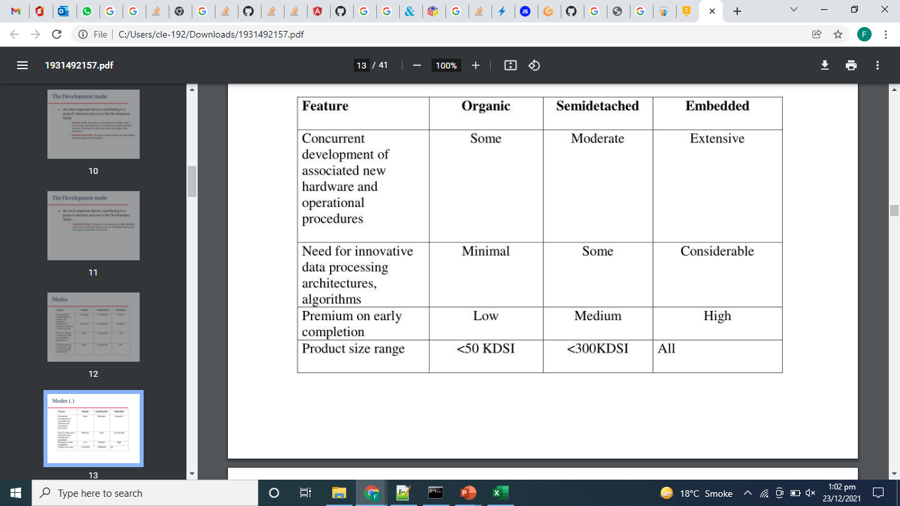
Modes

Slide 47
Cost Estimation Process
Cost = Size of the Project * Productivity

Slide 48
Basic COCOMO Model
Computes software development effort (and cost) as function of program size expressed in estimated lines of code
Model
Category | Ab | Bb | Cb | Db
Organic | 2.4 | 1.05 | 2.5 | 0.38
Semi-detached | 3.0 | 1.12 | 2.5 | 0.35
Embedded | 3.6 | 1.20 | 2.5 | 0.32

Slide 49
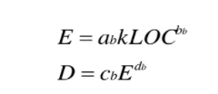
Basic COCOMO Equations
Where
E is effort in person-months
D is development time in months
KLOC is estimated number of line of codes

Slide 50
P = E/D
P total number of persons required to accomplish the project

Slide 51
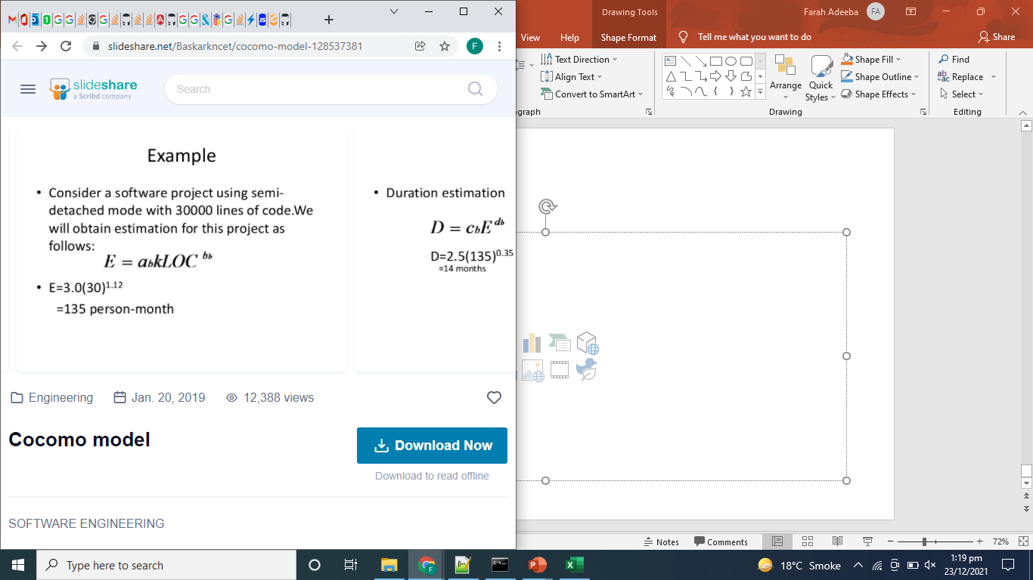
Example

Slide 52
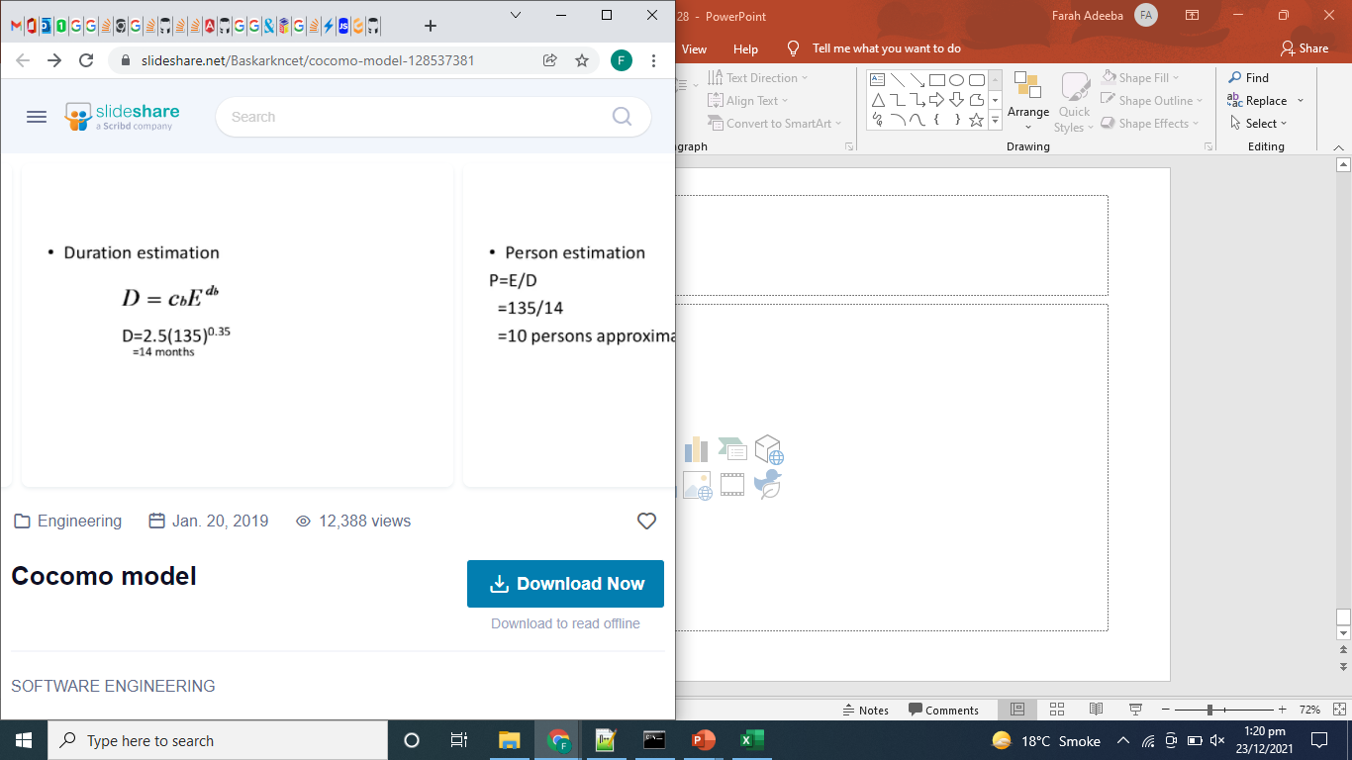

Slide 53
